Slide 1
SAT Participation in Oregon
Dimitri Kisten, DSI1
Project1
A look into stagnant college preparedness and potential fixes

Slide 2
Problem Statement
College Board’s primary revenue stream is from the participation of students taking the SAT. Since 2007 College Board has made $800 million while administering over 5 million exams in 2018, double what it administered in 2007. (Publica Audit)
Despite these facts there still exists some problems that could affect future profit/revenue:
Nearly 40 percent of accredited colleges have dropped the SAT requirement (Washington Post)
Only in 2018 did the SAT surpass the ACT in terms of # of tests taken since 2012 (Washington Post)
Underemployment is at 40% for new college grads which might lead students to reconsider even going to college (WSJ).

Slide 3
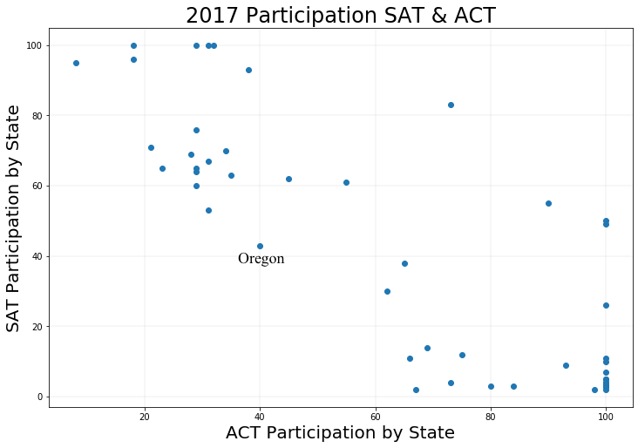
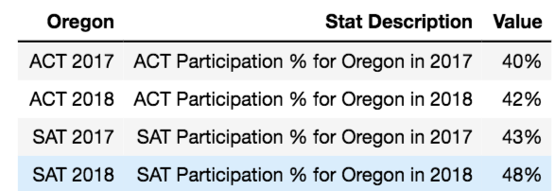
Methodology
Aimed to find where would be the best hub for investment to get students to participate in exams.
Ignored states with very high SAT participation, limited room for growth.
Ignored states where the ACT was mandated such as Hawaii, Alabama, Kentucky, Louisiana, etc.
Decided to focus on states that had a low participation for SAT and ACT, most room for growth.
This state was: Oregon with an avg. of 40% participation for both tests for both 2017 and 2018.
The next step was to research potential reasons for Oregon’s lapse in college preparedness.

Slide 4
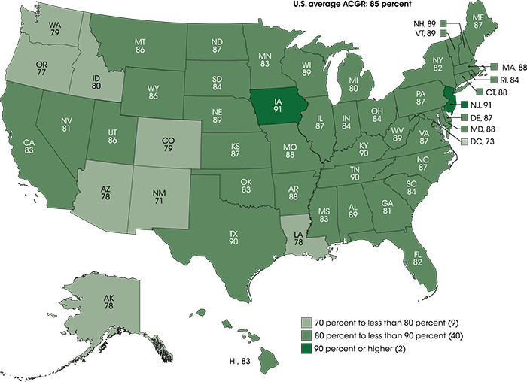
Analysis and Findings
Oregon Relative to Other States:
48th lowest high school graduation rate in the US (77%).
Ranks 2nd to last in terms of gap between low and high income students.
Only 13% of schools had funding at or above the national average for individual students.
Graduation Rates by State
(Figure via nces.ed.gov)

Slide 5
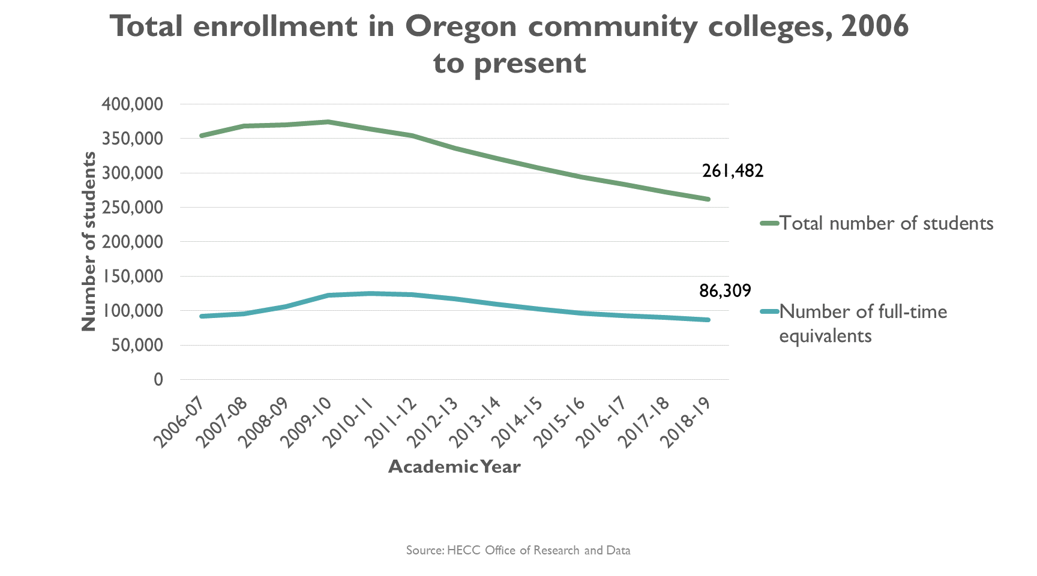
Findings cont.
In state enrollment has been declining since 2008.
Figure 3 (Oregon.gov)

Slide 6
Conclusions and Further Research
Oregon is severely lacking in resources to prepare students for college.
Decreasing college enrollment → Rise in unemployment → Crime rates? → Hindered economy?
Where does gov’t pour money?

Slide 7
Recommendations
Start a small campaign in select underperforming schools to show that funding college readiness (tutoring, test prep materials, practice tests, scoring well on the SAT) leads to higher graduation rates and eventual college admission.
No majority test = no pushback from state to favor one test over the other.
Gov’t would be more likely to mandate SAT and pour money into prep for it in order to avoid the risks stated before.
Low risk on College Board, high return through becoming eventual vendor for Oregon.

